Slide 1
‘Giving all South Tees children and young people the necessary support to build resilience to achieve good emotional health’

Slide 2
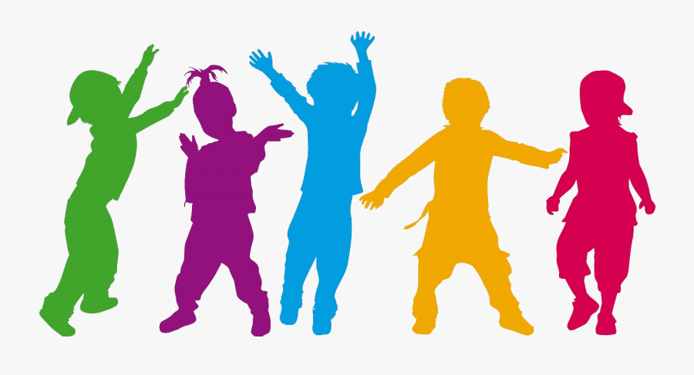
Icebreaker
30 seconds dance party!

Slide 3
Today’s session
What can you remember?
A bit more information on why we feel anxious
Tips and tricks
Healthy ways to manage anxiety – techniques
Relaxation time

Slide 4
Recap
What is anxiety?
(Another word for feeling worried or scared)
Do you think you are the only person who feels anxious or do you think everyone experiences anxiety?
(Its normal to feel anxious at times – everyone does.)
What might cause us to feel anxious?
(Big things like moving house, moving country, starting a new school. And small daily pressures like homework, arguments with friends, being late etc.)
Can anyone remember what happens in your body when you feel anxious? What are the physical symptoms of anxiety?
(Heart beating fast, feel hot and sweaty, tummy churning/butterflies, feel sick, feel shaky)
The body has an automatic reaction to fear – can anyone remember what that was called?
(FFF – fight, flight or freeze. Our body is very clever and prepares us to deal with a threat – so it sends adrenaline through the body to send blood to our muscles as well as other changes. In our modern world we don’t have the threat of coming face to face with a tiger but our bodies still respond in the same way if we feel under threat.)

Slide 5
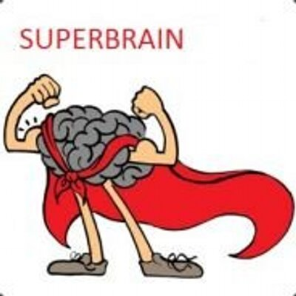
What else can you remember?
Jug of water – remember we all have our own jug of water which can fill up quickly if we start feeling stressed. What can we do to keep the level of water down?
(Relaxing and doing things we enjoy)
Ways to calm down? Can anyone remember any? We had quite a big list!
Talk to your friends or a trusted adult – this can really help
Imagine your favourite place where you feel calm, comfortable and happy
Get a cold drink of water
Squeeze something (play dough, clay, putty, stress ball etc)
Move your body – get active to release the stress and feel good
Sleep and eat well
Take time to relax

Slide 6
Calming your body and mind
Can anyone remember any of the practices we tried last week?
Grounding technique – using your senses to bring yourself into the present moment 5,4,3,2,1
Tense and relax
Relaxation story

Slide 7
Learning
Why do we feel anxious?
When humans were developing, we had an alarm system in our brain that warned us about things that might hurt us, like if a tiger was around, if there was a fire, or if someone was coming to hurt us. It would release chemicals in our brain that made us very focused on the problem so we could solve it, and made our hearts beat faster and our breathing shallow to prepare us to run away. You might also feel like you need to go to the toilet (another way your body is preparing for a long run away from something scary), or that you get pins and needles (blood rushing to your legs and arms for the same reason).

Slide 8
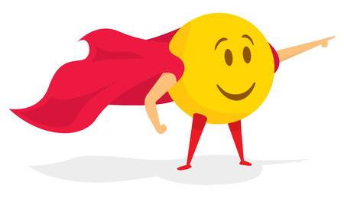
A helpful way to think about anxiety
Almost everything you feel when you’re scared was designed to protect you tens of thousands of years ago, but mostly just gets in the way now.
The problem today is that when you worry, there is no longer a tiger, but our brains release those same chemicals that would have kept our ancestors safe. It’s important to remember that all the feelings that anxiety brings to your body - your heart beating fast, not being able to think of anything else, feeling like you’re not breathing properly, as well as lots of other reactions - are completely normal. It can take some work to learn that when you feel those things, you don’t need to believe that it means danger. A lot of dealing with worry and anxiety is really just practising that thought: my body is feeling something very old that kept my ancestors safe.

Slide 9
If you do feel worried/anxious:
Breathe - in for 3 and our for 3
Remember these are just chemicals and they can’t hurt you
Remember you are in control
Talk about it
That could be with a teacher, a parent, an older sibling, or any adult you trust. They can help you to remember that the danger you’re fearing is not real. Sometimes when we lose someone, are separated from them, or there’s a big change coming for us, we also feel those same feelings of anxiety - these are also normal, but once again it’s important to find someone you trust that you can talk to. Getting your emotions out is a big part of feeling better.

Slide 10
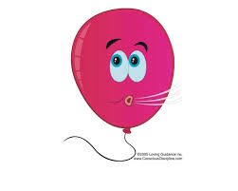
Tips and tricks
https://images.app.goo.gl/dG1R6yz6f6dFa1Vb7

Slide 11
More tips and tricks
Nervous and excited are the same thing
If you have butterflies in your stomach and feel nervous, remember that nervousness and excitement are actually the same chemical in your brain! If you tell yourself that you are excited for the speech you’re about to give or for the first day of school rather than nervous, then sometimes you can completely change how you feel.
Ask yourself questions
Question what you’re afraid of, and keep asking yourself questions until you realise that nothing will actually hurt you. Say you were afraid of talking in public. Why are you afraid?
“Why are you afraid?“ “I might make a mistake or say the wrong thing” “What would happen if you did that?” “People could laugh at me” “If people laugh at you what would happen then?” “I might look stupid and people might not like me” “Would you ever not be friends with someone if they said the wrong thing?” “Probably not unless they’d said something very mean on purpose”

Slide 12
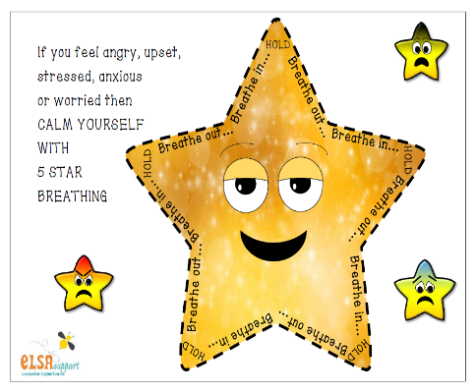
Activities – take five!

Slide 13
Body scan

Slide 14
Relaxation – Magic Bubble Blower

Slide 15
Evaluation
Any questions?

