Slide 1
Giving all South Tees children and young people the necessary support to build resilience to achieve good emotional health’

Slide 2
Icebreaker – Never have I ever game
Touched a worm
Played in the mud
Let a dog lick my face
Eaten cold pizza
Fallen out of my bed whilst sleeping
Danced in front of a mirror
Squished a snail with my foot
Gone surfing

Slide 3
Today’s session
What have we learned?
Are you using the practices?
What gets in the way of you using the practices?
Relaxation

Slide 4
Anxiety
We started by looking at want anxiety is – can anyone remember the words we used to describe it?
Worried/scared/concern/fear
Remember that it is very normal to feel anxious at times, everyone does. It’s good to talk about it to a trusted adult or to your friends.
We looked at examples of why we might feel anxious, can you remember some of them?
Can be triggered by big life changes such as moving house, starting a new school and also by daily smaller pressures like managing homework, being on time for school etc
We considered what anxiety can feel like in the body. What are the physical symptoms?
Racing heart, short of breath, feeling hot, butterflies, feeling sick, shaky
The body has an automatic reaction to fear, can you remember the name for this?
FFF Fight. Flight. Freeze
This helps our bodies spring into action when we feel under threat, these feelings and sensations can feel uncomfortable but they are not dangerous. In the modern world we don’t have to fight tigers but our bodies still respond in the same way to a perceived threat.

Slide 5
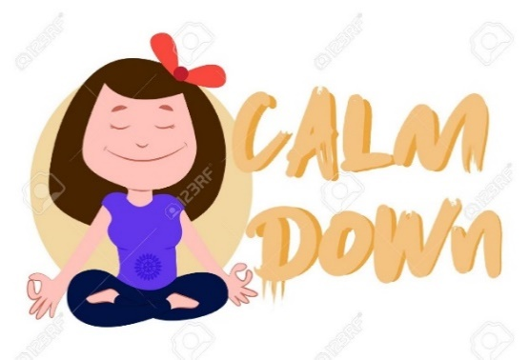
Healthy ways to manage anxiety
We discussed lots of techniques we can use to help us feel safe and calm. Which ones can you remember?
Talk About It- Talking about your feelings is one of the most powerful ways to control them. Tell a trusted person, like a parent, friend or teacher what you’re worried about
Imagine your favorite place - it’s like taking a mini vacation wherever you are.
Squeeze Something (play dough, clay, silly putty, your fists, a stress ball)
Sleep and eat well (they help your body function well)
Take time to relax and do activities that you enjoy
Move your body – get active to release the stress and feel good
5,4,3,2,1 grounding technique - calm yourself using your senses
Tense and relax muscle exercise
Relaxation for your mind – stories, breathing exercises.

Slide 6
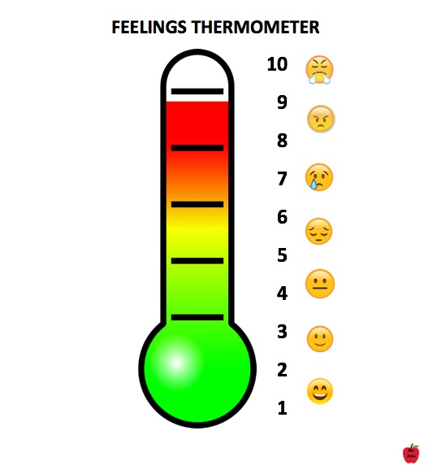
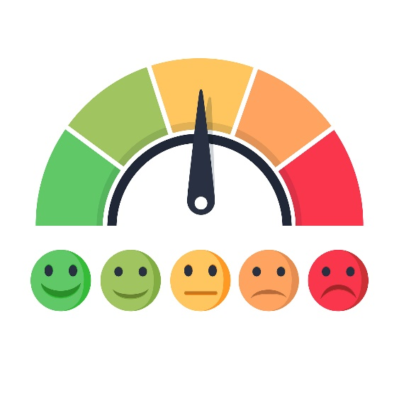
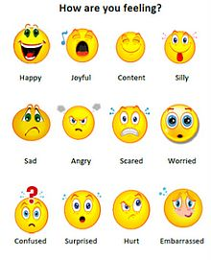
Feelings thermometer
We talked about our feelings being signals in our body
It is important that we listen to them as they give us clues about what is going on around us.
Some feelings are comfortable like happy or excited, some are uncomfortable like sad or angry.
We all have feelings and all of these feelings are OK!
It’s important to think about how you are feeling and when you feel uncomfortable,
remember that you can do things to move towards a more comfortable feeling instead.

Slide 7
Circle of control
What can you remember about the circle of control?
You all made your own circle of control and we did an exercise to look at what we can control and what we can’t control. E.g. we can control our own effort but we can’t control the weather.
The no.1 thing to remember was there are lots of things outside of our control but you will always have control over – your response or reaction to challenges and difficulties. Your response or reaction to the things outside of your control will always be your decision and that’s an important super power to hold on to.

Slide 8
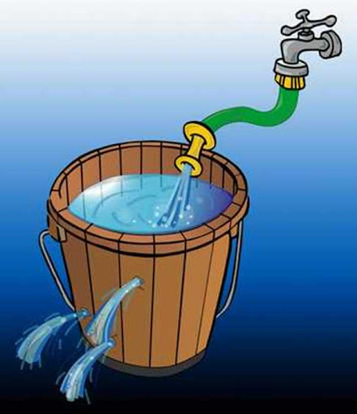
Stress buckets
What can you recall about stress buckets?
We are all born being different sized buckets, the bucket is our capacity to cope with stressful life events. There’s not much you can do about what sized bucket you are.
We all live under leaky stress taps, this represents the water that goes into the bucket – e.g. stressful life events. Some are not within our control.
All of our buckets have drain holes, this is good as they release the stress we experience. If we have good strategies for releasing stress our buckets won’t overflow.
You did your own stress bucket worksheet to think about what is causing the water going in the bucket and what are your drain holes? Have you been using your healthy outlets to keep the water level low?
Activities which can help to keep your bucket empty or at a low, manageable level are: Exercise, getting fresh air and being in nature, get good sleep, talking to people about your worries, laughing and mind control e.g. breathing exercises – 5 finger breathing, belly breathing, lazy eight breathing, ANYTHING that works for you ☺
Blocked holes = If you cope by doing unhelpful things then that can make the stress worse. This is like blocking the holes in your bucket. Unhelpful ways of coping are things like keeping your problems to yourself.

Slide 9
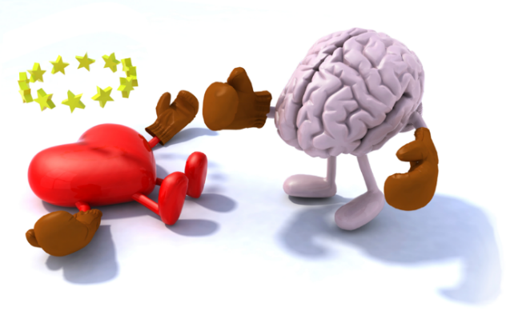
Thoughts, feelings and behaviours
Last time we looked at the two different squirrel stories to examine how different thoughts can make you feel and act in different ways.
Can you remember what happened?
We learned that actions are the things you do or the way you behave. Your thoughts and feelings have a big impact on how you act. If you feel happy you are likely to do nice things. But if you feel angry, you might want to act mean.
Different perceptions (thoughts) about the same situation can produce very different feelings and behaviours.

Slide 10
Triangle breathing
Remember we talked about doing the helpful activities all of the time to build up protection – keep in daily habits which help you.

Slide 11
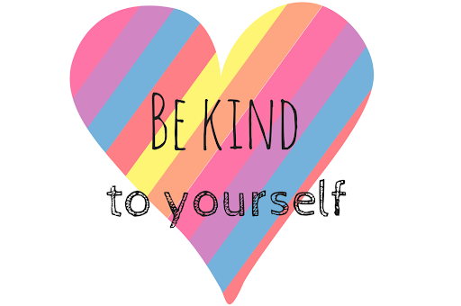
Group feedback
Have you been using the practices?
It’s like any new skill, it takes time to learn, that is why it is called a practice so be kind to yourself whilst you are learning.
What gets in the way of you using the practices?
Any questions?

Slide 12
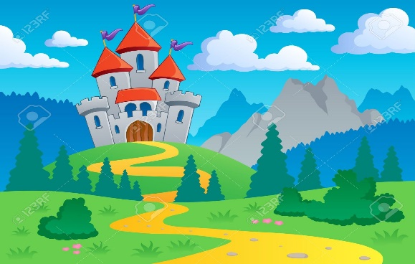
Relaxation story
1. Butterfly
2. Magic bubble blower
3. Rainbow waterfall
4. Beach
5. Inner Kingdom

Slide 13
Evaluation

