Slide 1
‘Giving all South Tees children and young people the necessary support to build resilience to achieve good emotional health’

Slide 2
Icebreaker – trivia game
Where is the smallest bone in the body? 2. Which planet is nearest to the sun?
Foot a) Saturn
Middle ear b) Mars
Hand c) Pluto
Nose d) Mercury
3. What does the Roman numeral C represent? 4. Which is the largest ocean?
5 a) Indian
20 b) Atlantic
100 c) Pacific
50 d) Arctic

Slide 3
Today’s session
Feelings
Circle of control
The Stress Bucket Story
Stress Bucket Activity
What if the coping strategies don’t work?
Relaxation practice

Slide 4
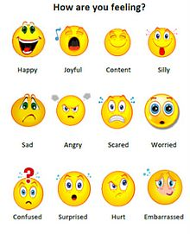
Feelings
Feelings are signals in our body and it is important that we listen to them as they give us clues about what is going on around us. Some feelings are comfortable like happy or excited, some are uncomfortable like sad or angry. We all have feelings and all of these feelings are OK!
It’s important to think about how you are feeling and when you feel uncomfortable, remember that you can do things to move towards a more comfortable feeling instead.
We all feel worried sometimes, lots of different things can make us feel worried. If something is worrying you, is there someone you can share your worry with?

Slide 5
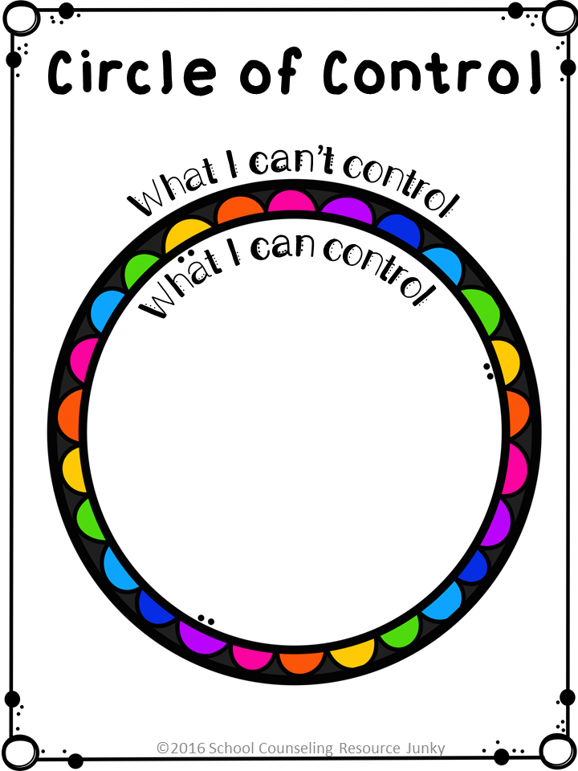

Slide 6
Circle of control
We all worry about things and can become stressed, but we do not always have control over what happens to us. Below are some stress factors that might affect us, place them in the correct circle, according to the level of control you have over them.
Remember the outer circle are things outside of your control and the inner circle are things you have total control over.
The weather If people like you Traffic
Your effort Other people’s actions Your words
Other people’s words Your choices Getting enough exercise
Your behaviour How often you smile Being honest

Slide 7
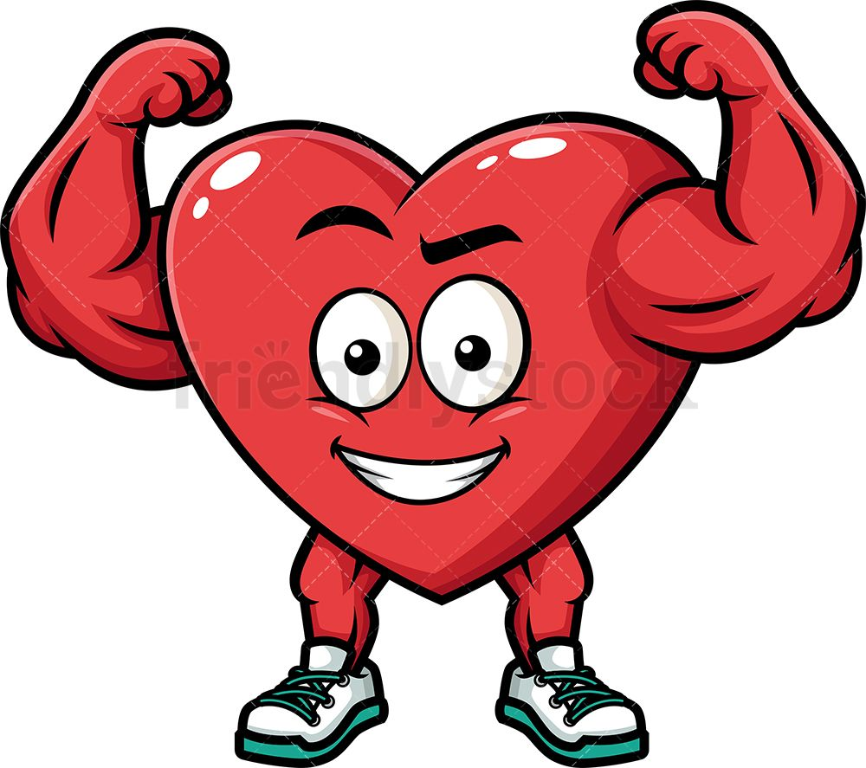
Circle of control
Talking about our circle of control and how we can react to things outside of our control. There are some things we can control and some things we cant control in our daily lives and during all of the interactions we have with other people -your friends, your family, teachers at school. There are many things we have control over and its quite empowering to think about all of the things you have control over in your life. They include:
Apologising when you make a mistake
The negatives or the positives that you choose to focus on
The kind of attitude you have
How truthful and honest you are
How often you smile
And how you respond to any challenges that happen
And many more……

Slide 8
Circle of control continued…..
In my control circle = My own actions/how I treat others/ getting enough sleep/my mindset. The goals I set for myself/the coping strategies I use/practicing gratitude/ when I help others/how I take care of myself
What about things that we can’t control?
The words of others, the opinion of others, the weather, if people like me, the choice of others, traffic, the feelings of others.
We have many interactions during the day with others and there are many things we don’t have control over like the opinions of others, or words that others use, whether other people like us or not, getting stuck in traffic or even things that have nothing to do with people but still upset our day like the weather.
So there are also lots of things outside of our control but you can remember the number 1 thing that you will always have control over – your response or reaction to challenges and difficulties and that’s pretty powerful. Your response or reaction to the things outside of your control will always be your decision and that’s an important super power to hold on to. Especially when you think how your reaction to things can affect your mindset, try and find the humour in a situation without getting frustrated or try taking some deep breaths – might help you take control in overwhelming situations.

Slide 9
The difference between influence and control
It’s important to understand the difference between what we control and what we influence. To control means that we have complete authority over. For example, we can control whether or not we eat a doughnut.
But I can’t control whether or not my friend Amy eats a doughnut. I might be able to convince her not to eat it. Or she might be inspired when she sees me resisting the doughnut. We can influence Amy, but we can’t control her.
That’s the difference. There is no uncertainty in control. If we can control, we can get exactly what we want. But influencing means we can impact it, but can’t guarantee the results we want.

Slide 10
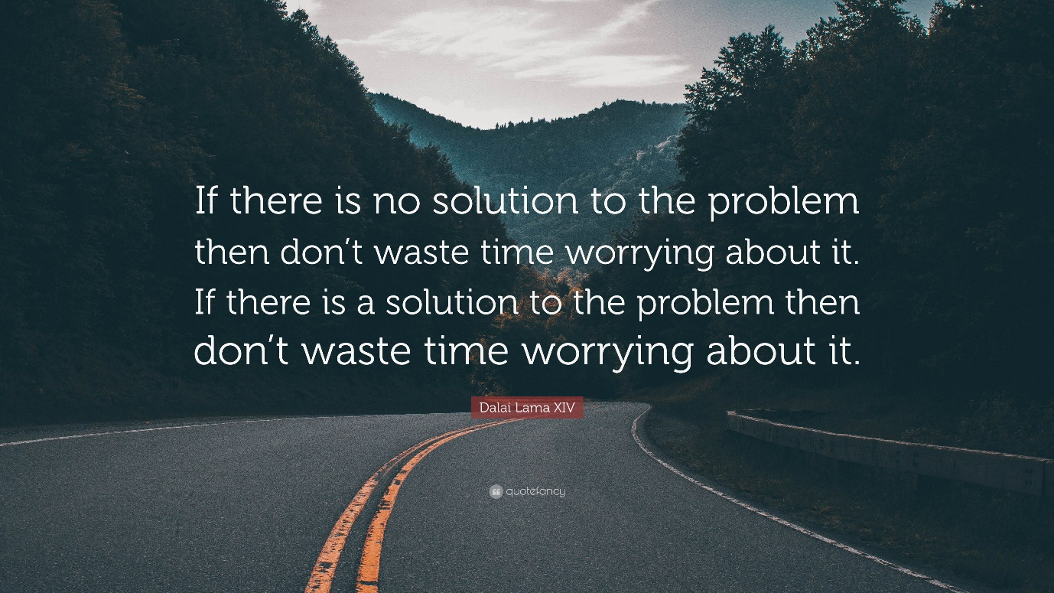
Improve your mind-set
The hardest part of worrying about uncertain situations is the point where you start to spiral. Your mind runs away with the worst-case scenario and you feel worse and worse.
This is where thinking about a course of action within your control helps significantly.

Slide 11
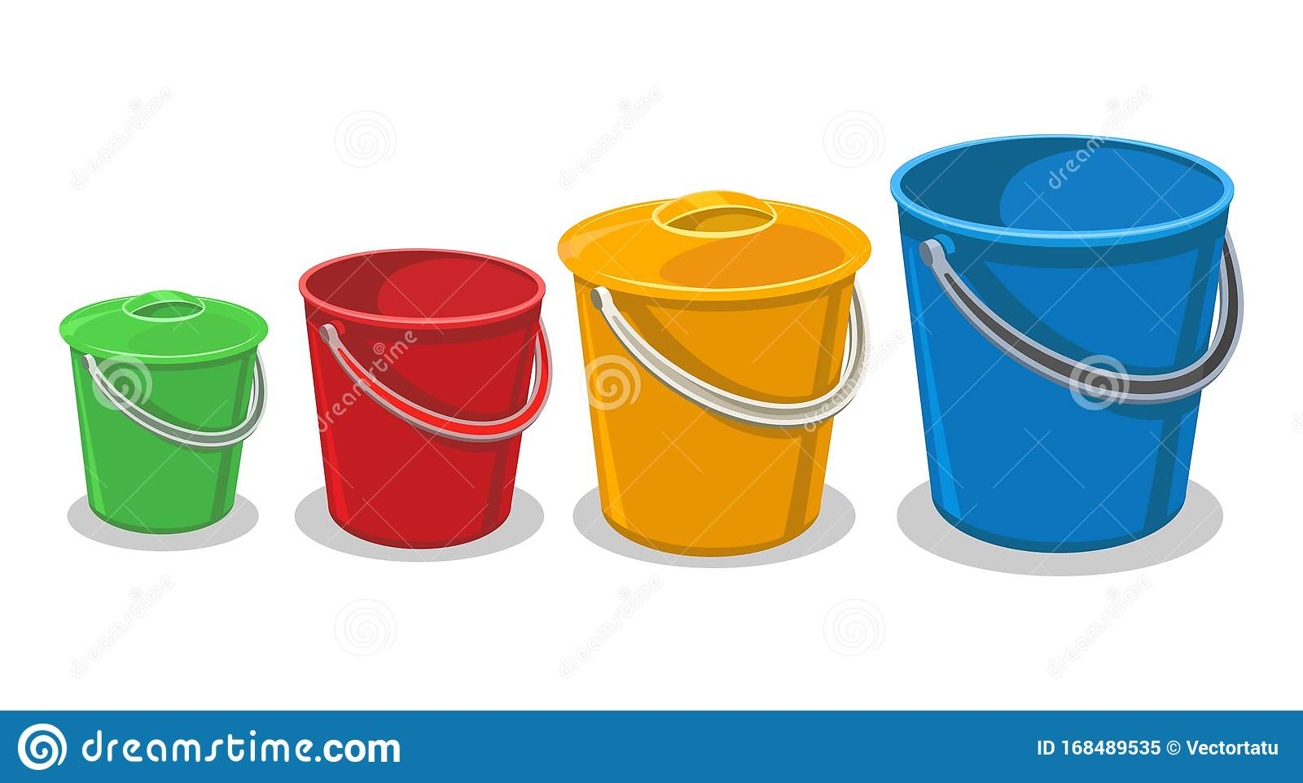
The stress bucket story
We are all born being different sized buckets, the bucket is our capacity to cope with stressful life events. There’s not much you can about what sized bucket you are.

Slide 12
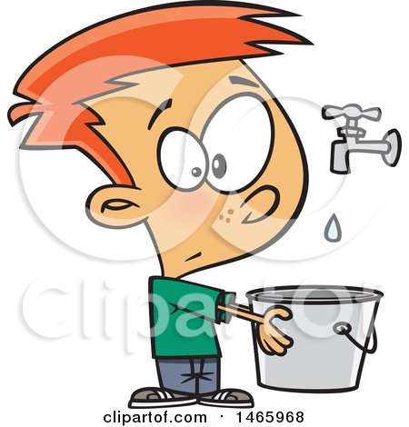
Stress buckets
We all live under leaky stress taps, the water that drips into the bucket represents our stressful life events. Many stressful life events are not within our control.

Slide 13
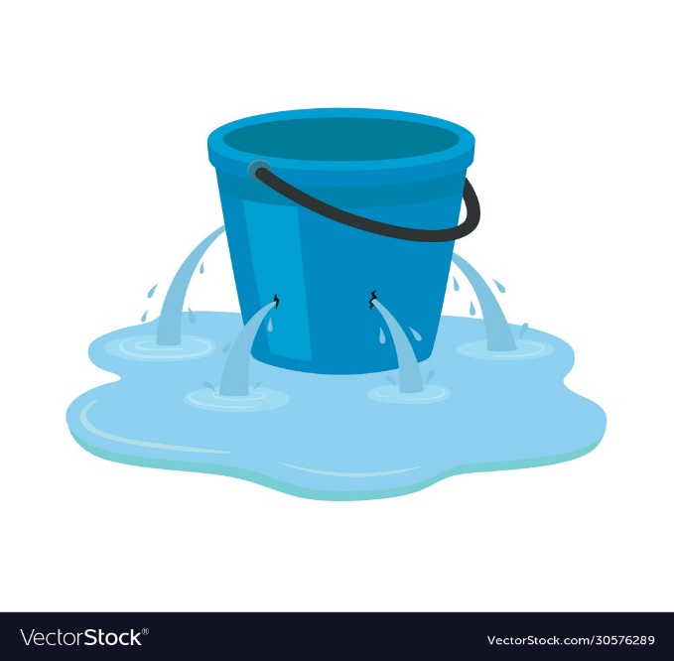
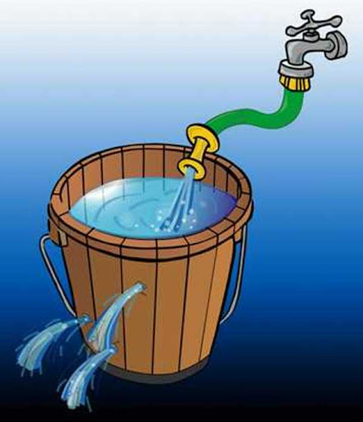
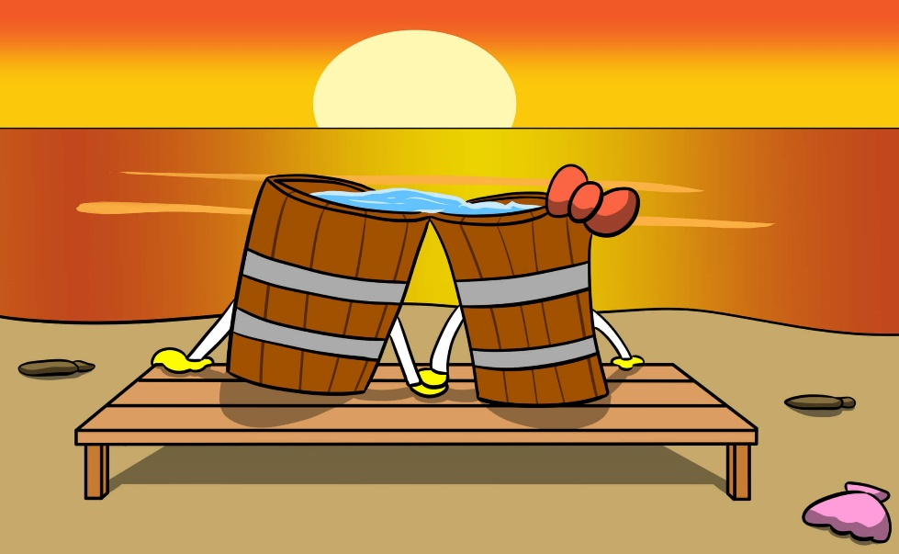
Stress buckets
All of our buckets have drain holes, this is good as they release the stress we experience. If we have good strategies for releasing stress our buckets won’t overflow. But sometimes our coping strategies can’t keep up with the stress we are experiencing. And sometimes we abandon our coping strategies when we need them the most. A full and overflowing bucket is where stress has reached unhelpful levels and this can affect how you feel. A bucket where the stress remains safely inside is one where stress is in check and is likely helping with productivity (we need a little bit of stress to keep us motivated).

Slide 14
Stress bucket activity

Slide 15
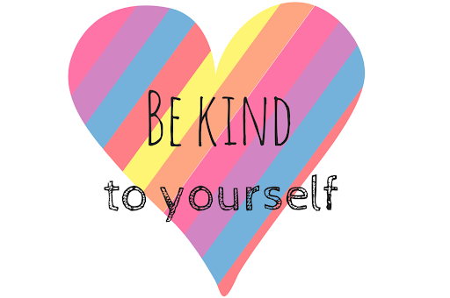
What if the techniques don’t work?
Firstly, keep being kind to yourself ☺ Sometimes when we feel like our healthy coping strategies aren’t working our inner voice might start to judge and be unkind, this can often make you feel worse so instead of saying to yourself ‘my coping techniques aren’t helping, I am useless, a failure etc.’ change that to a more compassionate attitude towards yourself acknowledging that all your feelings are valid, you have tried to use the strategies that work for you. Think about what you can do to make yourself feel better, self-care = stroke a pet, move your body, relax. Give yourself some space.
Try a new strategy that you haven’t tried before – if you usually draw, listen to music, watch your tv programme etc but none of them are working try going and running around the garden, making shapes out of the clouds in the sky or playing with a friend. And again keep that voice of kindness in your head, even thinking of something different to try and giving it a go is a positive step even if it didn’t work. Sometimes just the act of trying something different can help ease anxiety.
Very important is to practice these techniques all of the time, not just when you feel stressed or anxious. This builds up a layer of protection for times when we do feel less able to manage. It’s like a preventative measure for easing future anxiety.

Slide 16
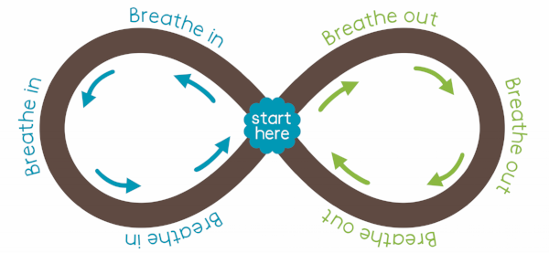
Relaxation practices
Lazy eight breathing
Draw an 8 on your piece of paper and then turn it on it’s side. Start in the middle, go up to the left and trace the left part of the 8 while you breathe in, nice and slowly, big, deep breath. When you get to the middle of the 8 again breathe out while you trace the right side of the eight with your finger.

Slide 17
Progressive muscle relaxation

Slide 18
Relaxation – rainbow waterfall

Slide 19
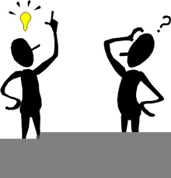
Evaluation
Any questions?

