Slide 1
Giving all South Tees children and young people the necessary support to build resilience to achieve good emotional health’

Slide 2
Icebreaker
Have a magical carpet that flies or your own personal robot?
Jump into a pool of chocolate pudding or a pool of strawberry ice-cream?
Not be allowed to watch tv for a year or not be allowed to eat any sweets for a year?
Play in the snow in the mountains or in the sand at the beach?
Be trapped in a room with a friendly tiger or with 10 bumblebees?
Be really fast or really strong?
Be friends with superman or spiderman?

Slide 3
Today’s session
Thoughts, feelings and behaviours
The difference between thoughts and feelings
Think – Feel – Do
Squirrel story 1
Squirrel story 2
Practising our healthy coping strategies

Slide 4
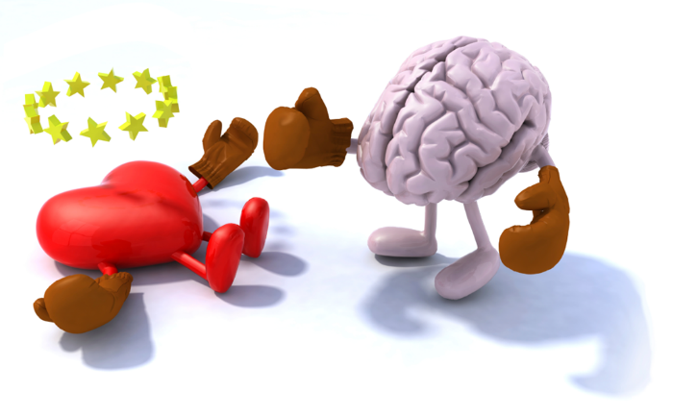
Separating thoughts and feelings
What is a thought?
What is a feeling?
Is feeling angry the same as “I’m going to knock my desk over”?
“I’m going to fail my test” (thought) is different than feeling nervous (feeling).
Thoughts are words we say to ourselves
Thoughts happen all of the time and often without us realising
Your thoughts create your feelings
Two people can have different thoughts about the same thing

Slide 5
Feelings Thoughts Behaviour
Feelings | Thoughts | Behaviour
Feelings | Thoughts | Behaviour
Delighted | “I have been lucky” | Kind to others
Miserable | “I hate her” | Shouting
Nervous | “What will happen now” | Crying
Cross | “It’s not my fault” | Punching

Slide 6
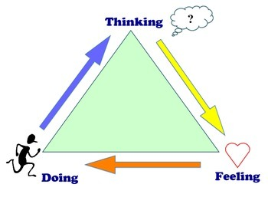
Feelings, thoughts and behaviour/actions
Everyone has problems, both big and small. To better solve your big problems it helps to learn how your thoughts, feelings and behaviour are connected.
Imagine you have an upcoming test and you think “I’m going to fail”. Because of this thought you start to worry. You are so worried that you feel sick just thinking about the test. Because it’s so uncomfortable you decide not to study.
The thought “I’m going to fail” led to a feeling (worry) which led to an action/behaviour (not studying).What might have changed if you had a different thought?

Slide 7
Thoughts – Feelings - Action
Thoughts are the words that run through your mind. They’re the things you tell yourself about what’s going on around you. There are many different thoughts you could have about a single situation.
Feelings come and go as different things happen to you. You might fee happy, angry and sad all in one day. Some feelings are uncomfortable but they are not bad. Everyone has these feelings from time to time.
Actions are the things you do or the way you behave. Your thoughts and feelings have a big impact on how you act. If you feel happy you are likely to do nice things. But if you feel angry, you might want to act mean.

Slide 8
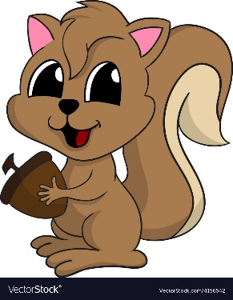
Squirrel story 1
No matter what our feelings are – they are all okay. Today we are looking at how are thoughts and feelings are connected. What would you say if I told you our feelings come from our thoughts? What do you think?
I’m going to tell you two versions of the same story about Squirrel, and we are going to see how Squirrel’s thoughts affected his feelings and his behaviour.
Create a grid with 3 columns – think, feel, do
Let me tell you about something that happened to Squirrel one day.
Squirrel was in his tree house when suddenly he saw another squirrel climbing up the tree toward him. Squirrel started thinking to himself, “That squirrel is coming to steal my acorns!”( Think column)
In pairs, reflect on what squirrel was thinking and guess how he might have felt. Try to think of as many feelings words as you can to describe squirrel’s feelings.
Group feedback

Slide 9
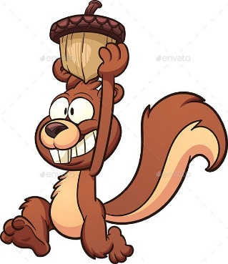
Squirrel story 1
Feelings might include: angry, mad ,annoyed, furious, scared worried, nervous, anxious.
If squirrel feels like this, guess what he might do when the other squirrel reaches the branch where he is sitting.
Pair work and feedback
Action – squirrel might get ready for a fight, yell at the other squirrel to go away, hide his acorns, start to cry, call for help.

Slide 10
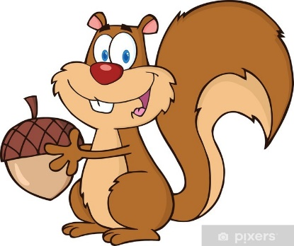
Squirrel story 2
Different perceptions (thoughts) about the same situation can produce very different feelings and behaviours.
So let’s change the story a little bit – what would happen if squirrel thought the other squirrel was climbing the tree for a different reason?...
One day, squirrel was in his tree house when suddenly he saw another squirrel climbing up the tree. Squirrel thought to himself “That squirrel is coming to visit me! Maybe we can have fun together!”
Think, feel, do columns – based on what squirrel is thinking, guess how he felt? Again, think of as many feeling words as you can, what do you think squirrel’s face and body looked like?
Feedback
Feelings might include: excited, happy, thrilled
Then what about what squirrel might do this time?
Feedback
Ask the other squirrel to play, jump for joy, invite friends over

Slide 11
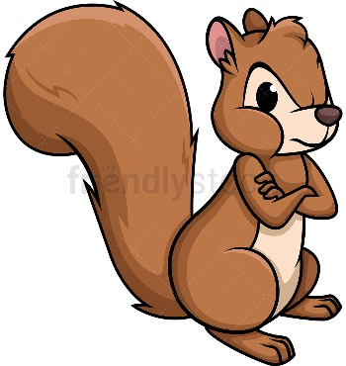
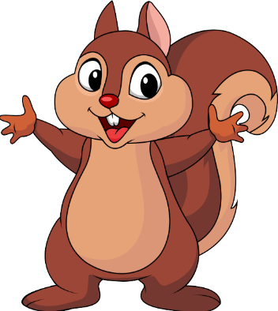
Compare and contrast
The squirrel’s feelings and actions in each situation directly resulted from his thoughts. In the first story what were squirrel’s thoughts?
How did that make him feel?
What did he do because of it?
In both cases his perception (thoughts about) the situation caused him to feel and act in specific ways.
We can think about the same situation in different ways.
Think about the two versions of the story and the different endings.

Slide 12
Triangle breathing

Slide 13
Relaxation story – Inner Kingdom

Slide 14
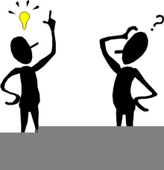
Evaluation
Any questions?

