Slide 1
Self-care workshop
Notes:
Introduce yourself and give a brief session outline which will include information and practical activities to try and to take away.

Slide 2
Notes:
Ask delegates On a scale of 1-10 where 1 is not confident at all and 10 is you feel really confident, how confident are you in addressing your own self-care needs and also encouraging others to look after theirs?

Slide 3
Ice breaker
Name one thing you do to cheer yourself up after a hard day?
Notes:
For those who have attended ARA training this is one of the questions we ask – it links into your own resilience and coping strategies.
Gove delegates a minute to think about their answers then ask for brief feedback, include some reflection on healthy/unhealthy practices and introduce resilience concept – how do you successfully bounce forward? Outline this is the first part of their self-care toolkit to take away from today and is likely something they already do without realising –praise everyone ☺

Slide 4
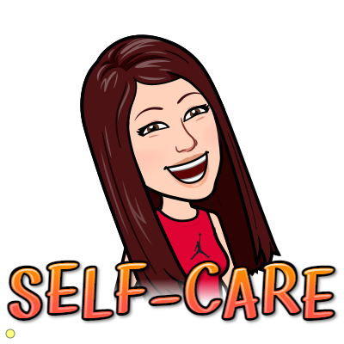
Self-care as a tool for wellbeing
https://youtu.be/AFEnl8KUo4U
Small, daily doses of self-care build up to offer a protective layer for general wellbeing.
Notes:
Ask for feedback from group reflecting on video

Slide 5
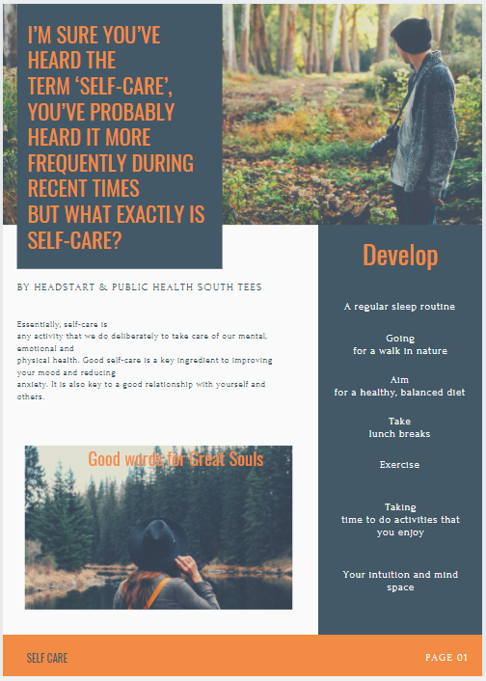
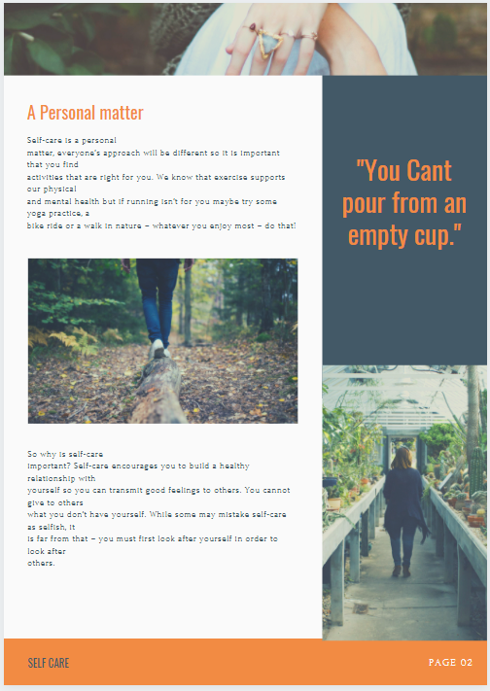
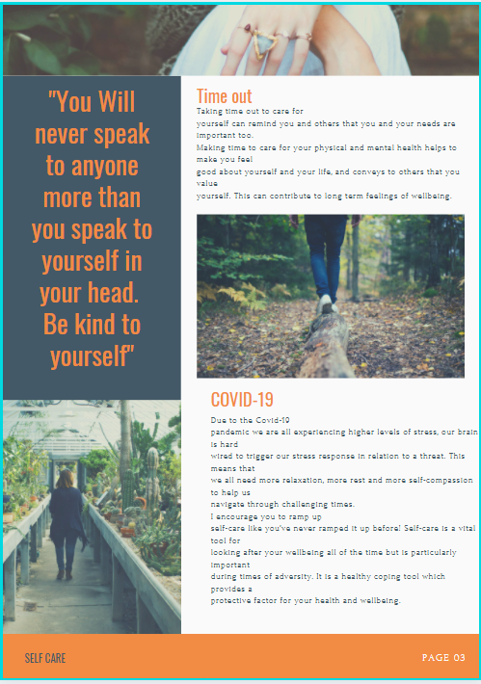
Information
Notes:
Explain a handy 3 page booklet is available with info and guidance about self care.
Content =
Explains what self-care is
Personalising your self-care and ideas for self-care activities
Why self-care is important
A section on why self-care is even more paramount during a global pandemic

Slide 6
Different types of self-care:

Slide 7
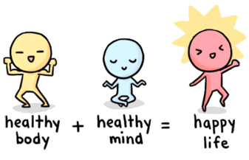
Mind apples: 5-a-day for your mind
We know to look after our physical health – we need to also look after our mental health. List 5 things you do to look after your mind?
Notes:
Group feedback + discussion about what works for you is unique but sometimes what usually works can stop working – good to try other people’s ideas and keep experimenting with what you need on any given day/moment. Thos ewho have attended ARA training will recognise this activity which we call Headstart Hearts.

Slide 8
Five ways to wellbeing
Notes:
Link these activities to self-care

Slide 9
More healthy coping tools (positive psychology)
Activity: reflect on three things that went well today?
Notes:
Outline that its good to have a menu of tools to choose from.

Slide 10
Summary and evaluation
During this session we hope you have gained better understanding or have been reminded of the importance of self-care – both doing it for yourself as a first port of call and also encouraging others to use it as a healthy coping tool for mental wellbeing.
Notes:
Ask attendees to make a personal pledge of something simple they can change on a weekly or even daily basis to increase their self-care (*remind them it doesn’t have to be big!!

Slide 11
Useful resources
Get Your Mind Plan - Every Mind Matters - NHS (www.nhs.uk)
Action for Happiness
Smiling Mind
Home - The Blurt Foundation (blurtitout.org)

